Slide 1
Decorator Pattern

Slide 2
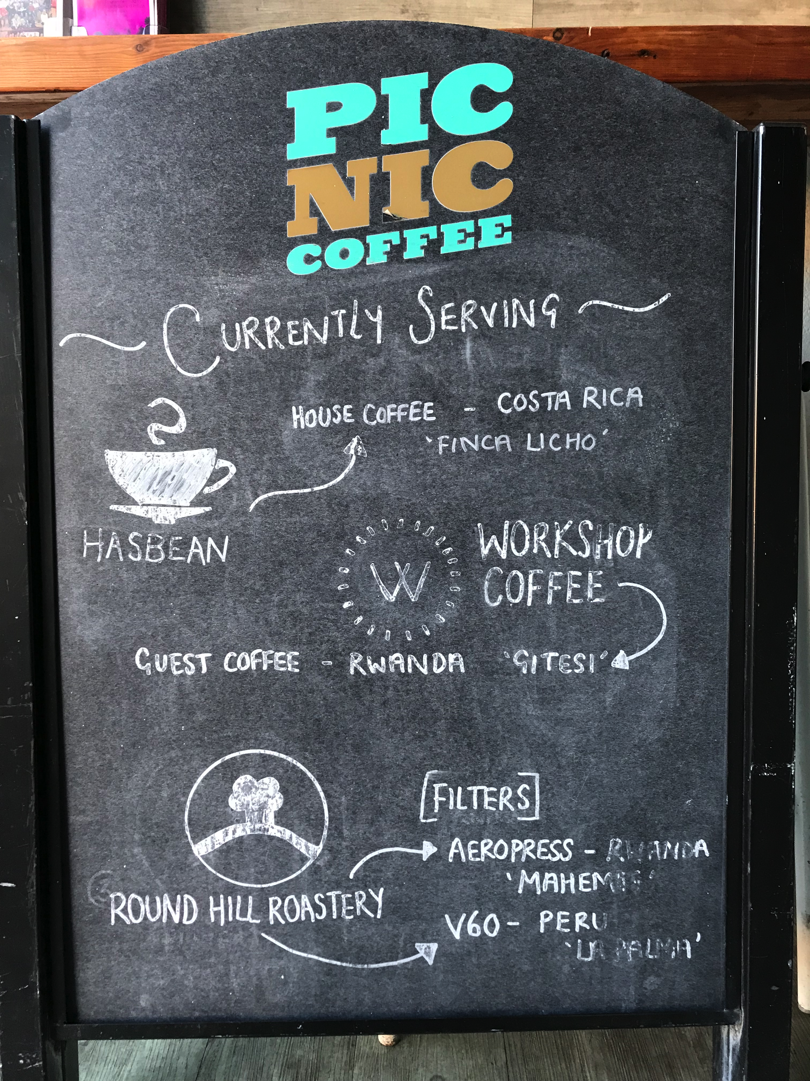
The Problem
CoffeeNews
…
+ send(coffeeList)
CoffeeNews
- news: CoffeeNews
+ setNews(news) + send(coffeeList)
E-mail sent
Notes:
Your local neighbourhood coffee shop regularly changes the coffees that they serve; to get customers to return sooner they want to send updates about the new coffees they have.
You build functionality which allows a third party add to create and configure the news object once and then send e-mail updates when new coffees are available.

Slide 3
The Problem
CoffeeNews
Email CoffeeNews
Facebook CoffeeNews
TextMess CoffeeNews
Email + TextMess CoffeeNews
Email + Facebook + TextMess CoffeeNews
Email + Facebook CoffeeNews
TextMess + Facebook CoffeeNews
Notes:
The coffee shop realises they have a multiple channels that people want to be contacted through and not all of their customers gave permission for e-mail notification. They need to make sure they are using all the channels available to them
Some customers have given permission for multiple channel contacts

Slide 4
Why not inheritance?
Subclasses using inheritance could:
Create a ‘diamond problem’
Generate subclasses for each possible combination
A
B
C
D

Slide 5
The Decorator Pattern
CoffeeNews
…
+ send(coffeeList)
Stack = new CoffeeNews()
If (EmailPermission)
stack = new EmailDecorator(stack)
If (FacebookPermission)
stack = new FacebookDecorator(stack)
If (TextMessPermission)
stack = new TextMessDecorator(stack)
app.setCoffeeNews(stack)
BaseDecorator
wrappee: CoffeeNews
+ BaseDecorator(CoffeeNews) + send(coffeeList)
EmailDecorator
…
+ send(coffeeList)
FacebookDecorator
…
+ send(coffeeList)
TextMessDecorator
…
+ send(coffeeList)

Slide 6
Pros and Cons
Pros
You can extend an object’s behaviour without making a new subclass.
You can combine several behaviours by wrapping an object into multiple decorators.
Adheres to the Single Responsibility Principle.
Cons
It’s hard to remove a specific wrapper from the wrappers stack.
It’s hard to implement a decorator in such a way that its behaviour doesn’t depend on the order in the decorators stack.

